Slide 1
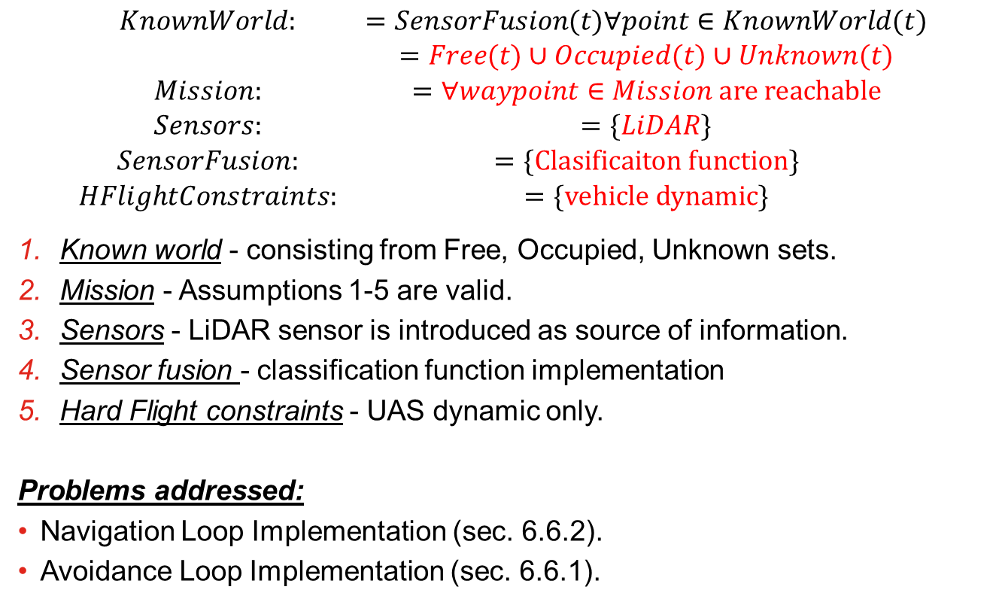
Incremental problem definition: [P1] Basic Avoidance
$$\begin{matrix}KnownWorld: & =SensorFusion(t)∀point∈KnownWorld(t) \\ & =Free(t)∪Occupied(t)∪Unknown(t) \\ Mission: & =∀waypoint∈Mission are reachable \\ Sensors: & =\{LiDAR\} \\ SensorFusion: & =\{Clasificaiton function\} \\ HFlightConstraints: & =\{vehicle dynamic\}\end{matrix}$$
Known world - consisting from Free, Occupied, Unknown sets.
Mission - Assumptions 1-5 are valid.
Sensors - LiDAR sensor is introduced as source of information.
Sensor fusion - classification function implementation
Hard Flight constraints - UAS dynamic only.
Problems addressed:
Navigation Loop Implementation (sec. 6.6.2).
Avoidance Loop Implementation (sec. 6.6.1).

Slide 2
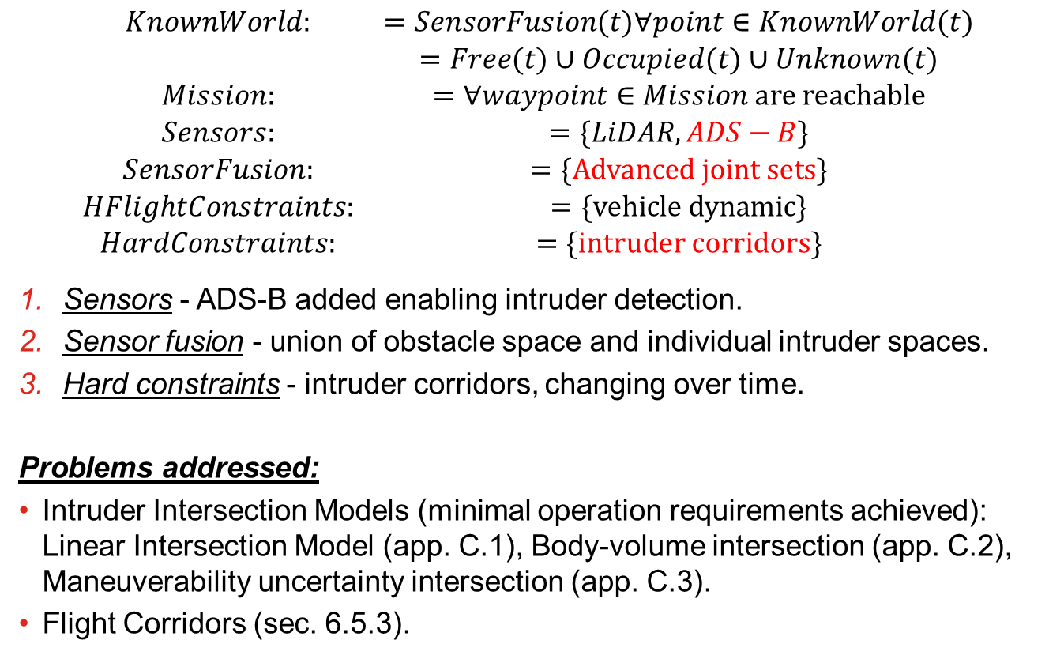
Incremental problem definition: [P2] Intruders Introduction
$$\begin{matrix}KnownWorld: & =SensorFusion(t)∀point∈KnownWorld(t) \\ & =Free(t)∪Occupied(t)∪Unknown(t) \\ Mission: & =∀waypoint∈Mission are reachable \\ Sensors: & =\{LiDAR,ADS−B\} \\ SensorFusion: & =\{Advanced joint sets\} \\ HFlightConstraints: & =\{vehicle dynamic\} \\ HardConstraints: & =\{intruder corridors\}\end{matrix}$$
Sensors - ADS-B added enabling intruder detection.
Sensor fusion - union of obstacle space and individual intruder spaces.
Hard constraints - intruder corridors, changing over time.
Problems addressed:
Intruder Intersection Models (minimal operation requirements achieved): Linear Intersection Model (app. C.1), Body-volume intersection (app. C.2), Maneuverability uncertainty intersection (app. C.3).
Flight Corridors (sec. 6.5.3).

Slide 3
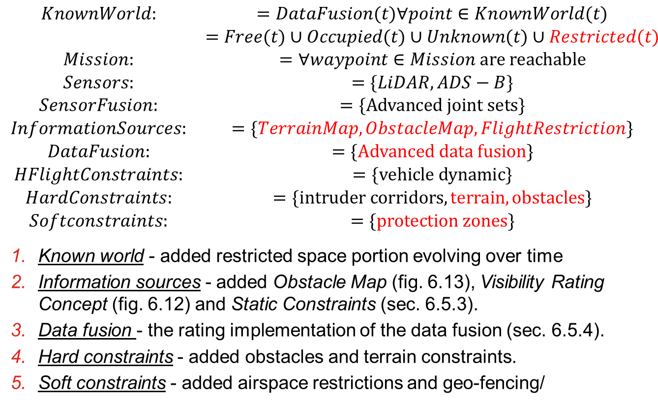
Incremental problem definition: [P3] Static restrictions
$$\begin{matrix}KnownWorld: & =DataFusion(t)∀point∈KnownWorld(t) \\ & =Free(t)∪Occupied(t)∪Unknown(t)∪Restricted(t) \\ Mission: & =∀waypoint∈Mission are reachable \\ Sensors: & =\{LiDAR,ADS−B\} \\ SensorFusion: & =\{Advanced joint sets\} \\ InformationSources: & =\{TerrainMap,ObstacleMap,FlightRestriction\} \\ DataFusion: & =\{Advanced data fusion\} \\ HFlightConstraints: & =\{vehicle dynamic\} \\ HardConstraints: & =\{intruder corridors,terrain,obstacles\} \\ Softconstraints: & =\{protection zones\}\end{matrix}$$
Known world - added restricted space portion evolving over time
Information sources - added Obstacle Map (fig. 6.13), Visibility Rating Concept (fig. 6.12) and Static Constraints (sec. 6.5.3).
Data fusion - the rating implementation of the data fusion (sec. 6.5.4).
Hard constraints - added obstacles and terrain constraints.
Soft constraints - added airspace restrictions and geo-fencing/

Slide 4
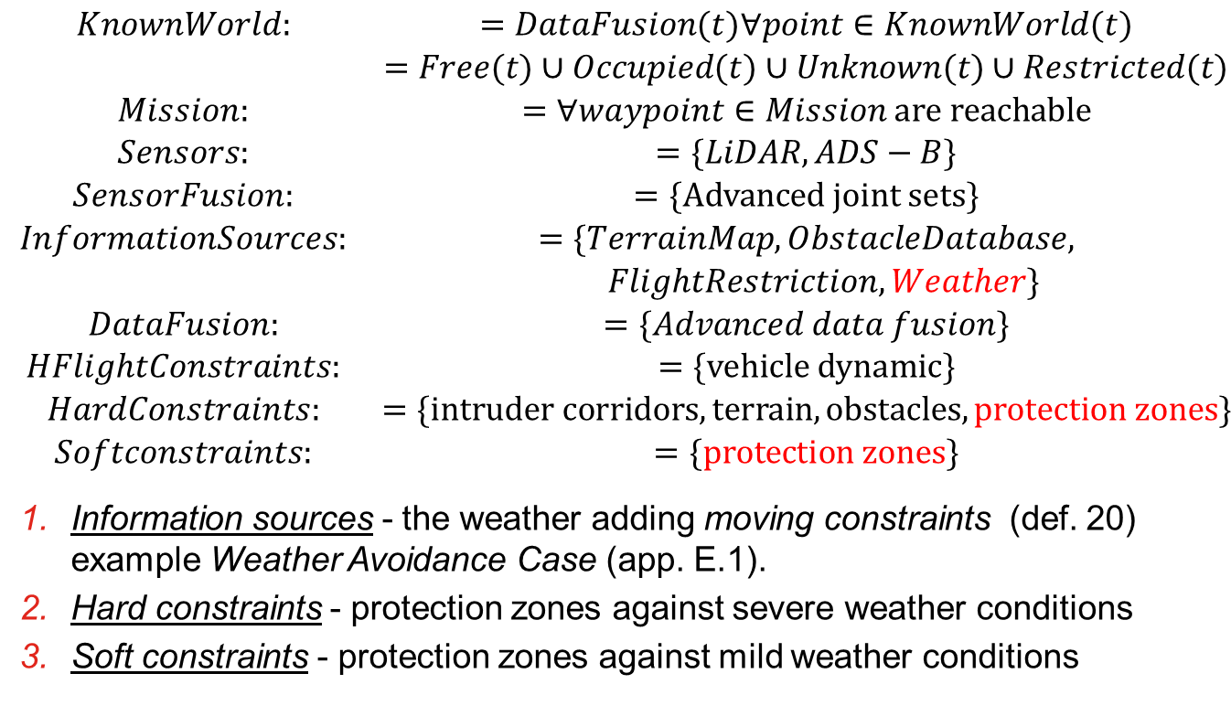
Incremental problem definition: [P4] Dynamic restrictions
$$\begin{matrix}KnownWorld: & =DataFusion(t)∀point∈KnownWorld(t) \\ & =Free(t)∪Occupied(t)∪Unknown(t)∪Restricted(t) \\ Mission: & =∀waypoint∈Mission are reachable \\ Sensors: & =\{LiDAR,ADS−B\} \\ SensorFusion: & =\{Advanced joint sets\} \\ InformationSources: & =\{TerrainMap,ObstacleDatabase, \\ & FlightRestriction,Weather\} \\ DataFusion: & =\{Advanced data fusion\} \\ HFlightConstraints: & =\{vehicle dynamic\} \\ HardConstraints: & =\{intruder corridors,terrain,obstacles, protection zones\} \\ Softconstraints: & =\{protection zones\}\end{matrix}$$
Information sources - the weather adding moving constraints (def. 20) example Weather Avoidance Case (app. E.1).
Hard constraints - protection zones against severe weather conditions
Soft constraints - protection zones against mild weather conditions

Slide 5
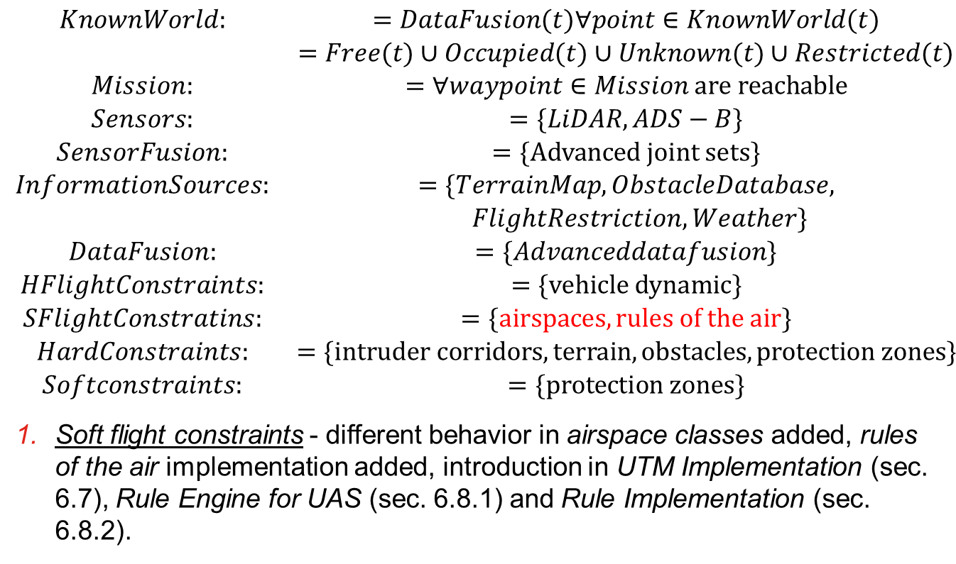
Incremental problem definition: [P5] Rules of the air
$$\begin{matrix}KnownWorld: & =DataFusion(t)∀point∈KnownWorld(t) \\ & =Free(t)∪Occupied(t)∪Unknown(t)∪Restricted(t) \\ Mission: & =∀waypoint∈Mission are reachable \\ Sensors: & =\{LiDAR,ADS−B\} \\ SensorFusion: & =\{Advanced joint sets\} \\ InformationSources: & =\{TerrainMap,ObstacleDatabase, \\ & FlightRestriction,Weather\} \\ DataFusion: & =\{Advanceddatafusion\} \\ HFlightConstraints: & =\{vehicle dynamic\} \\ SFlightConstratins: & =\{airspaces, rules of the air\} \\ HardConstraints: & =\{intruder corridors,terrain,obstacles, protection zones\} \\ Softconstraints: & =\{protection zones\}\end{matrix}$$
Soft flight constraints - different behavior in airspace classes added, rules of the air implementation added, introduction in UTM Implementation (sec. 6.7), Rule Engine for UAS (sec. 6.8.1) and Rule Implementation (sec. 6.8.2).

